Slide 1
Chapter 20 Lists, Stacks, Queues, and Priority Queues

Slide 2
Data Structure
A collection of data organized in some fashion
Stores the data
Provides/supports operations for accessing and maintaining the data
Define a class to contain data
Use the built in data structures

Slide 3
Provided Data Structures
Collection – stores elements in a sequential order
List
ArrayList
Linked List
Vector – Same as ArrayList except it contains synchronized methods
Stack – subclass of Vector
Push and pop methods to add/remove items
Last-in, first-out structure
Queues - interface
Priority queues – element with the highest priority is removed first
Requires Comparator
Linked List – Use this to implement a queue
Set - Unordered so cannot access through index
HashSet
LinkedHashSet
TreeSet
Map – Tag/Value pair
HashMap
LinkedHashMap
TreeMap

Slide 4
Java Collection Framework hierarchy
A collection is a container object that holds a group of objects, often referred to as elements. The Java Collections Framework supports three types of collections, named lists, sets, and maps.

Slide 5
Collection Interface
Defines common operations for lists, vectors, stacks, queues, priority queues and sets
Major types of containers
Set – stores non-duplicating values
Collection of elements – collection
Storing key/value pairs – Map
Interface for AbstractCollection class
Provides implementation of Collection methods except size and iterator
Notes:
Sets store – non-duplicate elements
Lists – store an ordered collection of elements
Queue – store objects that are processed first-in, first-out

Slide 6
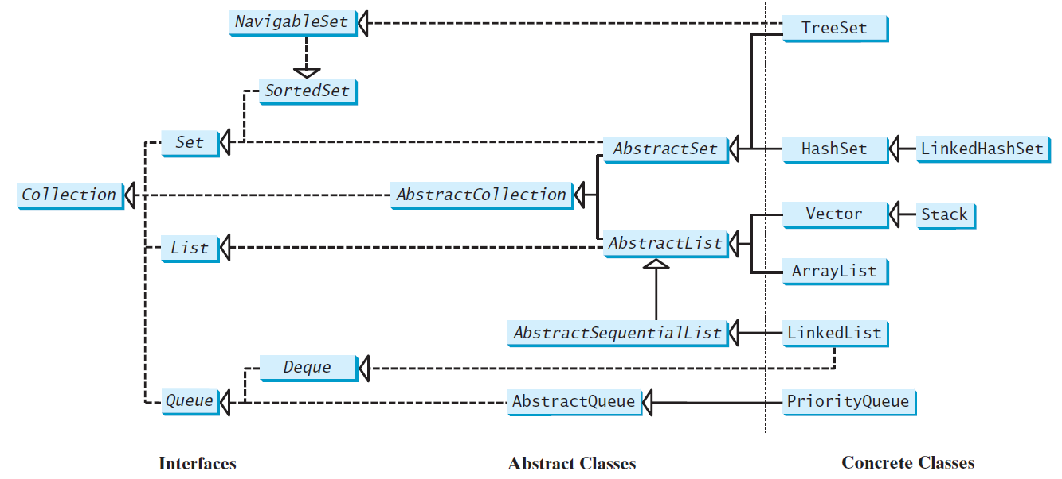
Java Collection Framework hierarchy, cont.
Set and List are sub-interfaces of Collection.

Slide 7
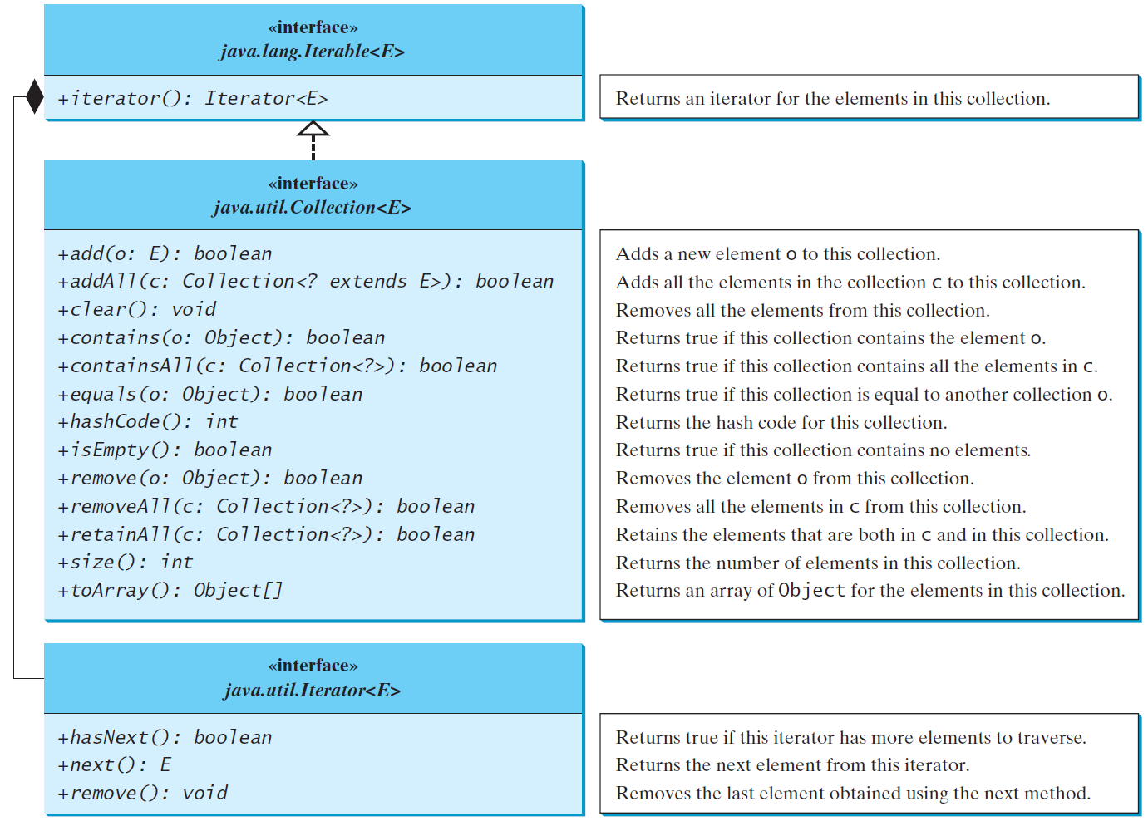
The Collection Interface
The Collection interface is the root interface for manipulating a collection of objects.

Slide 8
The List Interface
A list stores elements in a sequential order, and allows the user to specify where the element is stored. The user can access the elements by index.

Slide 9
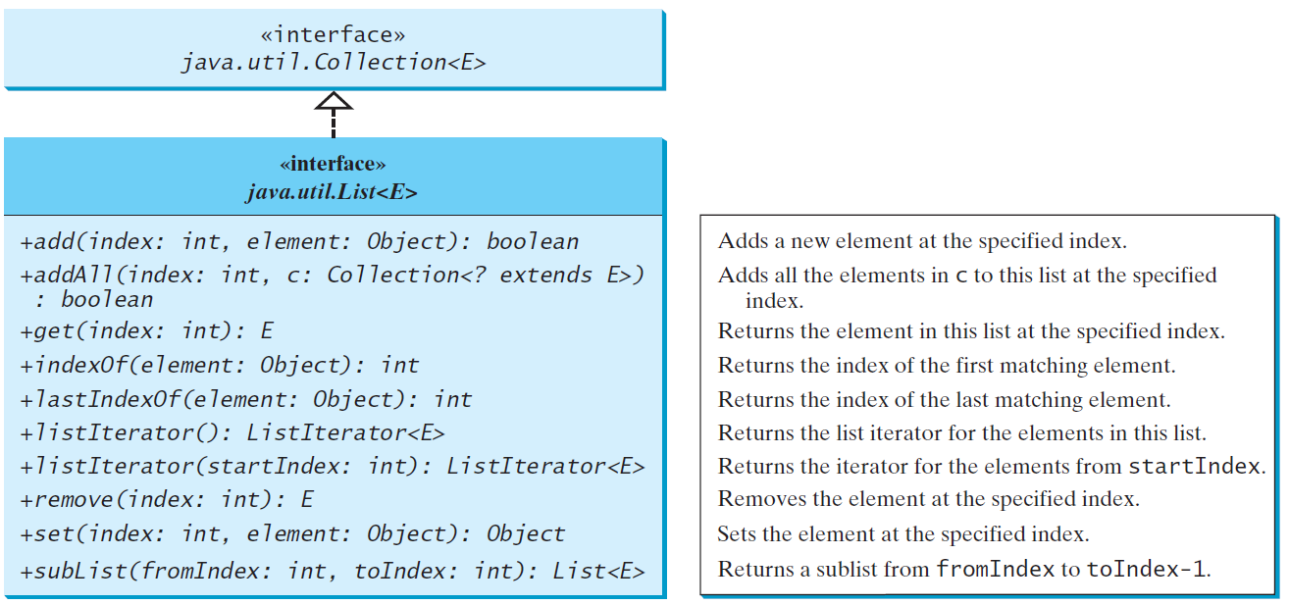
The List Interface, cont.

Slide 10
Iterator
Design pattern for walking through a data structure without having to expose the details of how data is stored

Slide 11
ListIterator
Create from the list
Allows us to traverse the list
hasNext
next
previous
remove
add
Other methods

Slide 12
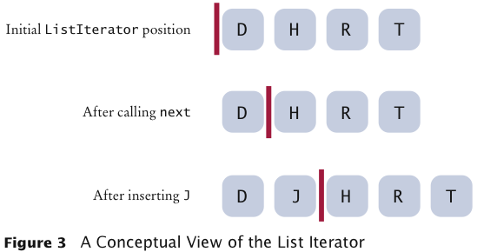
Concept of List Iterator

Slide 13
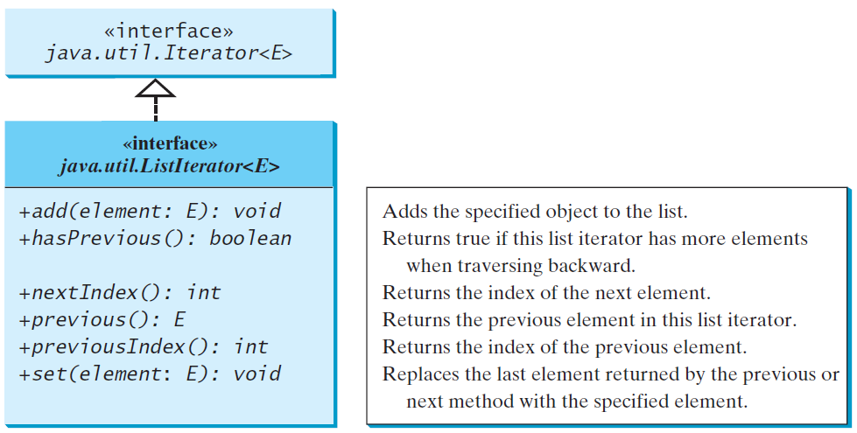
The List Iterator

Slide 14
ArrayList and LinkedList
Concrete implementations of the List interface.
Your specific needs determines which to use.
ArrayList if you need to support random access through an index without inserting or removing elements from any place other than the end
LinkedList if your application requires the insertion or deletion of elements from any place in the list
A list can grow or shrink dynamically.
Array is fixed once it is created.

Slide 15
java.util.ArrayList

Slide 16
java.util.LinkedList

Slide 17
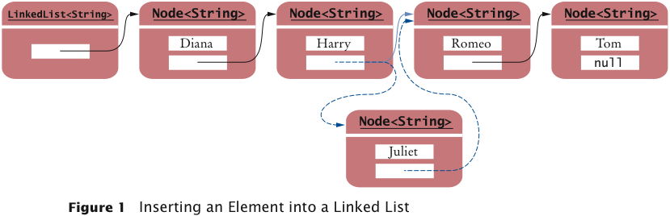
Node
Data
Reference

Slide 18
The Comparator Interface
Compare elements of different types
May not be instances of Comparable
Define a class that implements the java.util.Comparator interface
compare
Takes two objects
You write the comparison to return an int difference

Slide 19
The Comparator Interface
public int compare(Object element1, Object element2)
Returns a negative value if element1 is less than element2, a positive value if element1 is greater than element2, and zero if they are equal.

Slide 20
The Collections Class
The Collections class contains various static methods for operating on collections and maps, for creating synchronized collection classes, and for creating read-only collection classes.

Slide 21
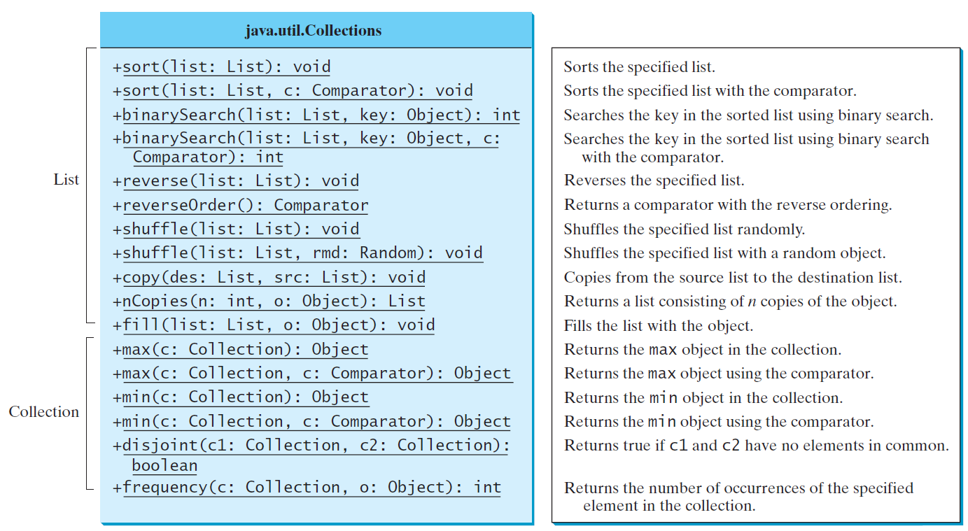
The Collections Class UML Diagram

Slide 22
The Vector Class
In Java 2, Vector is the same as ArrayList, except that Vector contains the synchronized methods for accessing and modifying the vector.
None of the new collection data structures introduced so far are synchronized.

Slide 23
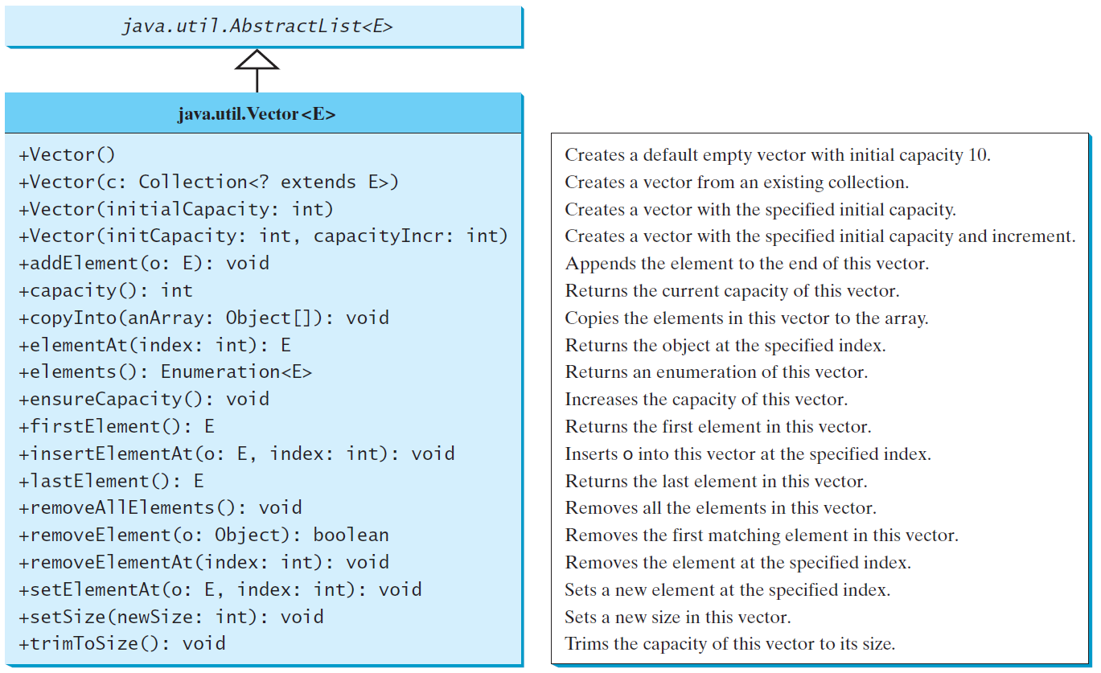
The Vector Class, cont.

Slide 24
Stacks and Queues
Stack
Collection of items
Last in
First out
Queue
Collection of items
First in
First out

Slide 25
The Stack Class
The Stack class represents a last-in-first-out stack of objects. The elements are accessed only from the top of the stack. You can retrieve, insert, or remove an element from the top of the stack.

Slide 26

Stacks
Allows insertion and removal on one end
Top of the stack
Push new items on stack
Pop items off the stack
LIFO
Last item added is first removed

Slide 27

Queue
Add items to the end of the queue
The Tail
Remove from the other end
The Head
Queues store first in first out
Removed in the same order they are added

Slide 28
Queues and Priority Queues
A queue is a first-in/first-out data structure. Elements are appended to the end of the queue and are removed from the beginning of the queue. In a priority queue, elements are assigned priorities. When accessing elements, the element with the highest priority is removed first.

Slide 29
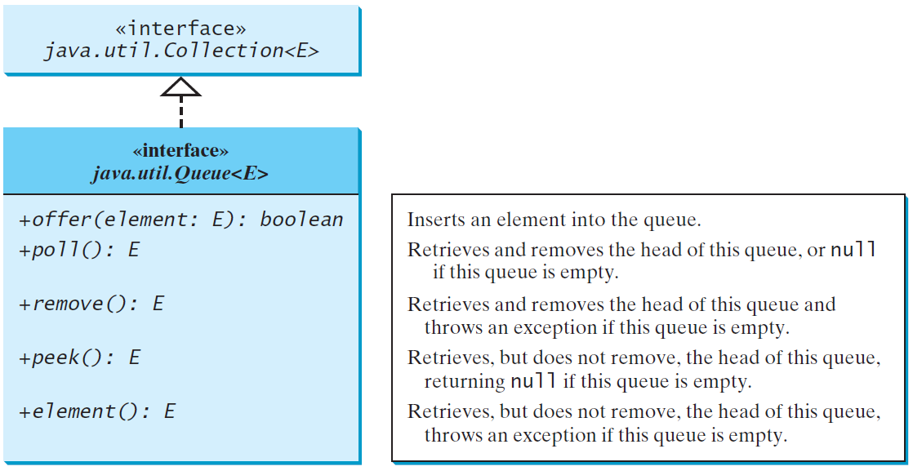
The Queue Interface

Slide 30
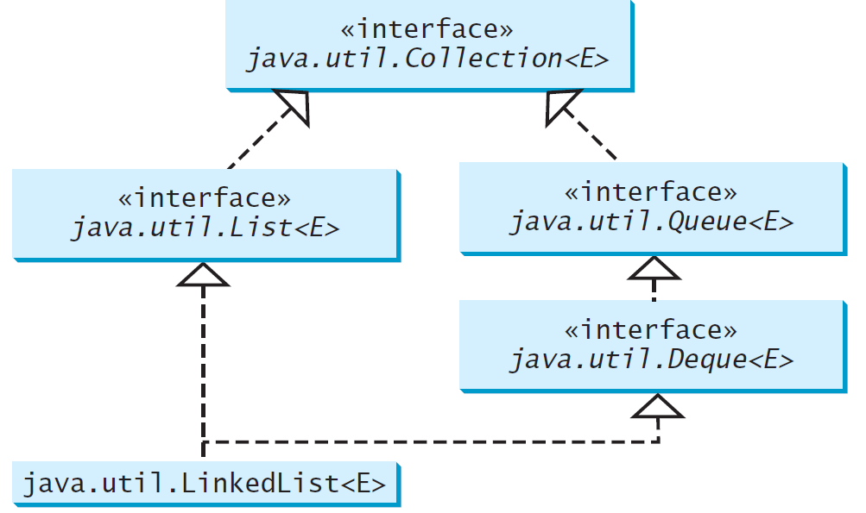
Using LinkedList for Queue

Slide 31
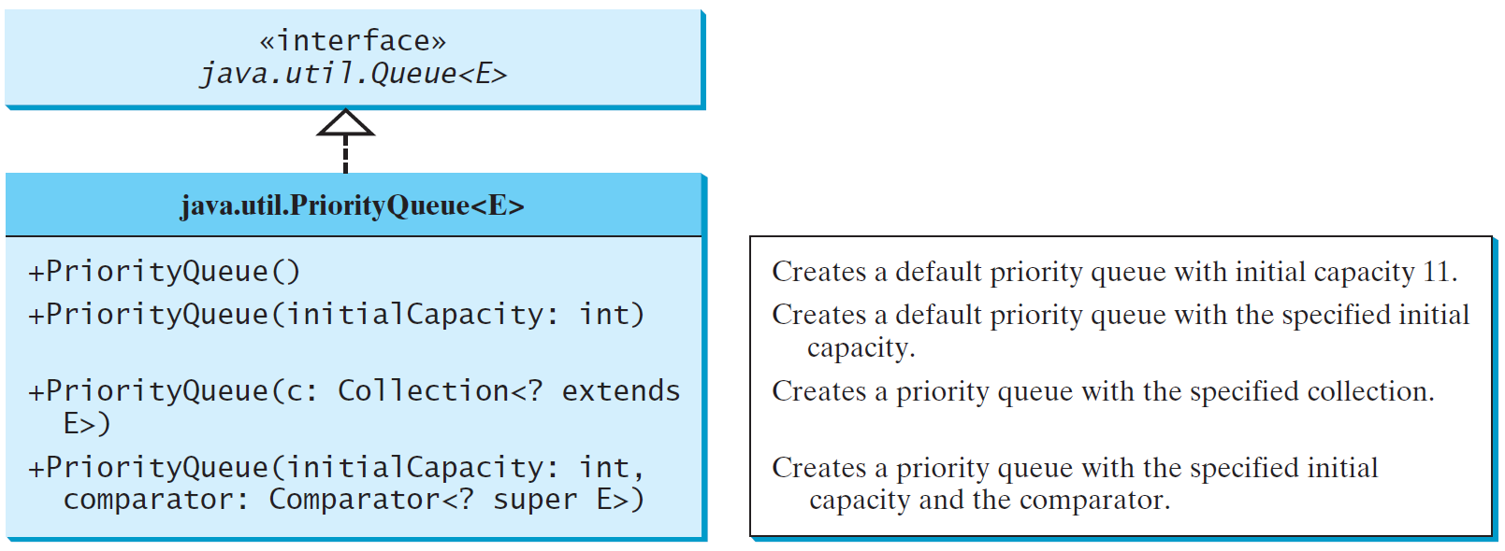
The PriorityQueue Class

Slide 32
Not on Test

Slide 33
Set
Set: Unordered collection of distinct elements
Elements can be added, located, and removed
Sets don’t have duplicates

Slide 34
Fundamental Operations on a Set
Adding an element
Adding an element has no effect if the element is already in the set
Removing an element
Attempting to remove an element that isn’t in the set is silently ignored
Containment testing (Does the set contain a given object?)
Listing all elements (in arbitrary order)

Slide 35
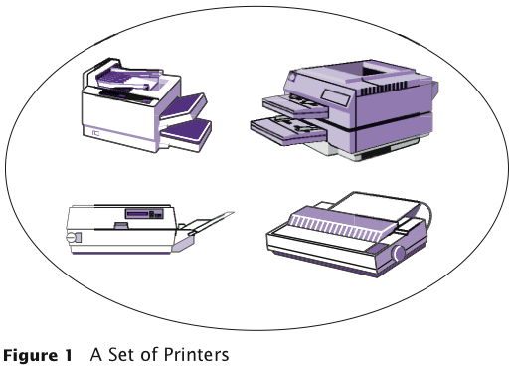
A Set of Printers

Slide 36
Sets
We could use a linked list to implement a set
Adding, removing, and containment testing would be relatively slow
There are data structures that can handle these operations much more quickly
Hash tables
Trees

Slide 37
Sets
Standard Java library provides set implementations based on both data structures
HashSet
TreeSet
Both of these data structures implement the Set interface
As a rule of thumb, use a hash set unless you want to visit the set elements in sorted order

Slide 38
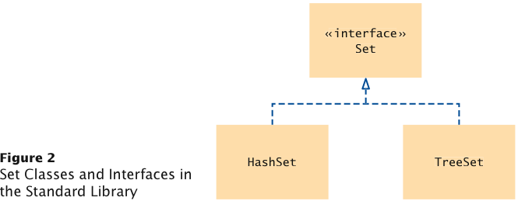
Set Classes and Interface in the Standard Library

Slide 39
Maps
A map keeps associations between key and value objects
Mathematically speaking, a map is a function from one set, the key set, to another set, the value set
Every key in a map has a unique value
A value may be associated with several keys
Classes that implement the Map interface
HashMap
TreeMap
Both of these data structures implement the Map interface

Slide 40
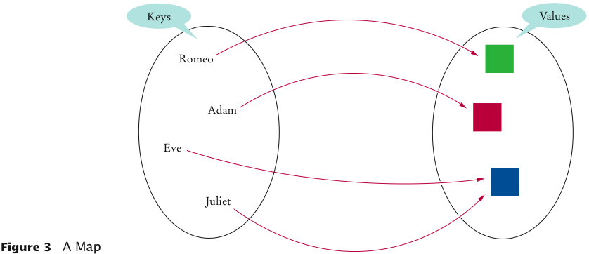
An Example of a Map

Slide 41
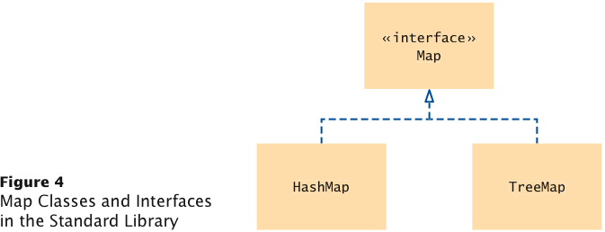
Map Classes and Interfaces

Slide 42
Using a Map
Example: Associate names with colors
Construct the Map:
Map<String, Color> favoriteColors =
new HashMap<String, Color>();
or
Map<String, Color> favoriteColors =
new TreeMap<String, Color>();
Add an association:
favoriteColors.put("Juliet", Color.RED);
Change an existing association:
favoriteColors.put("Juliet",Color.BLUE);

Slide 43
Using a Map
Get the value associated with a key:
Color julietsFavoriteColor =
favoriteColors.get("Juliet”);
Remove a key and its associated value:
favoriteColors.remove("Juliet");

Slide 44
Printing Key/Value Pairs
Set<String> keySet = m.keySet(); for (String key : keySet) { Color value = m.get(key); System.out.println(key + ” : " + value); }

